Slide 1
Chapter 22 Input/Output

Slide 2
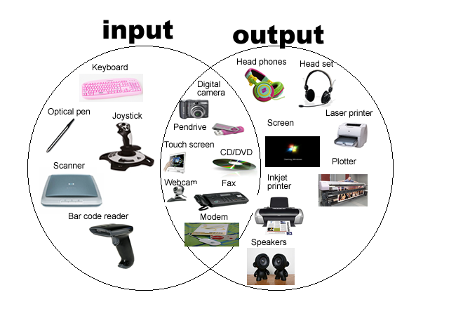

Slide 3
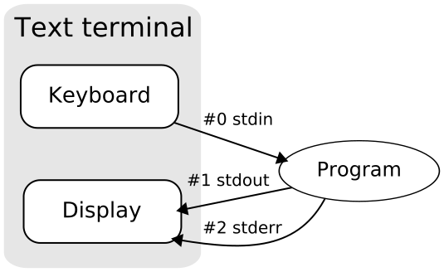

Slide 4
Introduction
C’s input/output library is the biggest and most important part of the standard library.
The <stdio.h> header is the primary repository of input/output functions, including printf, scanf, putchar, getchar, puts, and gets.
This chapter provides more information about these six functions.
It also introduces many new functions, most of which deal with files.

Slide 5
Introduction
Topics to be covered:
Streams, the FILE type, input and output redirection, and the difference between text files and binary files
Functions designed specifically for use with files, including functions that open and close files
Functions that perform “formatted” input/output
Functions that read and write unformatted data (characters, lines, and blocks)
Random access operations on files
Functions that write to a string or read from a string

Slide 6
Introduction
In C99, some I/O functions belong to the <wchar.h> header.
The <wchar.h> functions deal with wide characters rather than ordinary characters.
Functions in <stdio.h> that read or write data are known as byte input/output functions.
Similar functions in <wchar.h> are called wide-character input/output functions.

Slide 7
Streams
In C, the term stream means any source of input or any destination for output.
Many small programs obtain all their input from one stream (the keyboard) and write all their output to another stream (the screen).
Larger programs may need additional streams.
Streams often represent files stored on various media.
However, they could just as easily be associated with devices such as network ports and printers.

Slide 8
File Pointers
Accessing a stream is done through a file pointer, which has type FILE *.
The FILE type is declared in <stdio.h>.
Certain streams are represented by file pointers with standard names.
Additional file pointers can be declared as needed:
FILE *fp1, *fp2;

Slide 9
Standard Streams and Redirection
<stdio.h> provides three standard streams:
File Pointer Stream Default Meaning
stdin Standard input Keyboard
stdout Standard output Screen
stderr Standard error Screen
These streams are ready to use—we don’t declare them, and we don’t open or close them.

Slide 10
Standard Streams and Redirection
The I/O functions discussed in previous chapters obtain input from stdin and send output to stdout.
Many operating systems allow these default meanings to be changed via a mechanism known as redirection.

Slide 11
Standard Streams and Redirection
A typical technique for forcing a program to obtain its input from a file instead of from the keyboard:
demo <in.dat
This technique is known as input redirection.
Output redirection is similar:
demo >out.dat
All data written to stdout will now go into the out.dat file instead of appearing on the screen.

Slide 12
Standard Streams and Redirection
Input redirection and output redirection can be combined:
demo <in.dat >out.dat
The < and > characters don’t have to be adjacent to file names, and the order in which the redirected files are listed doesn’t matter:
demo < in.dat > out.dat
demo >out.dat <in.dat

Slide 13
Standard Streams and Redirection
One problem with output redirection is that everything written to stdout is put into a file.
Writing error messages to stderr instead of stdout guarantees that they will appear on the screen even when stdout has been redirected.

Slide 14
Text Files versus Binary Files
<stdio.h> supports two kinds of files: text and binary.
The bytes in a text file represent characters, allowing humans to examine or edit the file.
The source code for a C program is stored in a text file.
In a binary file, bytes don’t necessarily represent characters.
Groups of bytes might represent other types of data, such as integers and floating-point numbers.
An executable C program is stored in a binary file.

Slide 15
Text Files versus Binary Files
Text files have two characteristics that binary files don’t possess.
Text files are divided into lines. Each line in a text file normally ends with one or two special characters.
Windows: carriage-return character ('\x0d') followed by line-feed character ('\x0a')
UNIX and newer versions of Mac OS: line-feed character
Older versions of Mac OS: carriage-return character

Slide 16
Text Files versus Binary Files
Text files may contain a special “end-of-file” marker.
In Windows, the marker is '\x1a' (Ctrl-Z), but it is not required.
Most other operating systems, including UNIX, have no special end-of-file character.
In a binary file, there are no end-of-line or end-of-file markers; all bytes are treated equally.

Slide 17
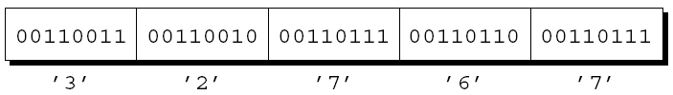
Text Files versus Binary Files
When data is written to a file, it can be stored in text form or in binary form.
One way to store the number 32767 in a file would be to write it in text form as the characters 3, 2, 7, 6, and 7:

Slide 18
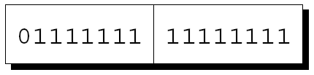
Text Files versus Binary Files
The other option is to store the number in binary, which would take as few as two bytes:
Storing numbers in binary can often save space.

Slide 19
Text Files versus Binary Files
Programs that read from a file or write to a file must take into account whether it’s text or binary.
A program that displays the contents of a file on the screen will probably assume it’s a text file.
A file-copying program, on the other hand, can’t assume that the file to be copied is a text file.
If it does, binary files containing an end-of-file character won’t be copied completely.
When we can’t say for sure whether a file is text or binary, it’s safer to assume that it’s binary.

Slide 20
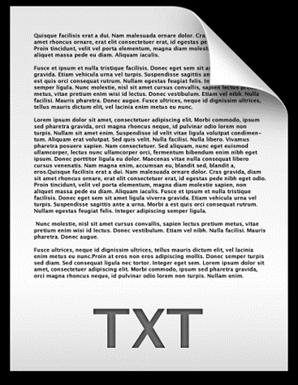
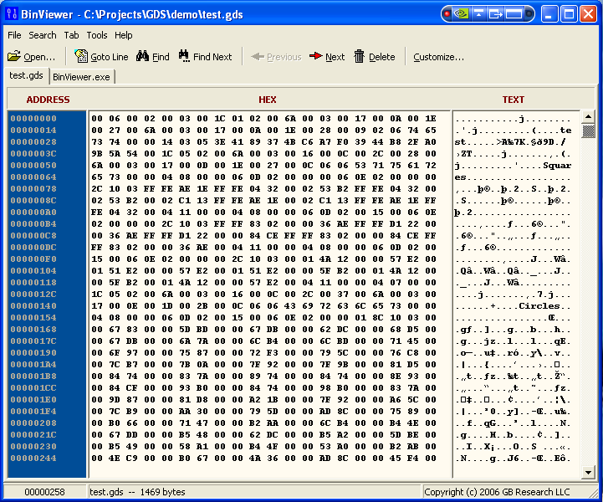

Slide 21
File Operations
Simplicity is one of the attractions of input and output redirection.
Unfortunately, redirection is too limited for many applications.
When a program relies on redirection, it has no control over its files; it doesn’t even know their names.
Redirection doesn’t help if the program needs to read from two files or write to two files at the same time.
When redirection isn’t enough, we’ll use the file operations that <stdio.h> provides.

Slide 22
File operations =?
Open/Close I/D/M/S

Slide 23
Opening a File
Opening a file for use as a stream requires a call of the fopen function.
Prototype for fopen:
FILE *fopen(const char * restrict filename,
const char * restrict mode);
filename is the name of the file to be opened.
This argument may include information about the file’s location, such as a drive specifier or path.
mode is a “mode string” that specifies what operations we intend to perform on the file.

Slide 24
Opening a File
The word restrict appears twice in the prototype for fopen.
restrict, which is a C99 keyword, indicates that filename and mode should point to strings that don’t share memory locations.
The C89 prototype for fopen doesn’t contain restrict but is otherwise identical.
restrict has no effect on the behavior of fopen, so it can usually be ignored.

Slide 25
Opening a File
In Windows, be careful when the file name in a call of fopen includes the \ character.
The call
fopen("c:\project\test1.dat", "r")
will fail, because \t is treated as a character escape.
One way to avoid the problem is to use \\ instead of \:
fopen("c:\\project\\test1.dat", "r")
An alternative is to use the / character instead of \:
fopen("c:/project/test1.dat", "r")

Slide 26
Opening a File
fopen returns a file pointer that the program can (and usually will) save in a variable:
fp = fopen("in.dat", "r");
/* opens in.dat for reading */
When it can’t open a file, fopen returns a null pointer.

Slide 27
Modes
Factors that determine which mode string to pass to fopen:
Which operations are to be performed on the file
Whether the file contains text or binary data

Slide 28
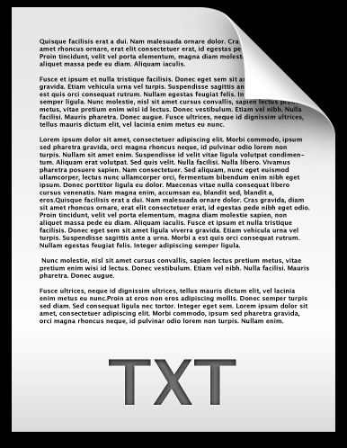
Modes
Mode strings for text files:
String Meaning
"r" Open for reading
"w" Open for writing (file need not exist)
"a" Open for appending (file need not exist)
"r+" Open for reading and writing, starting at beginning
"w+" Open for reading and writing (truncate if file exists)
"a+" Open for reading and writing (append if file exists)

Slide 29
Modes
Mode strings for binary files:
String Meaning
"rb" Open for reading
"wb" Open for writing (file need not exist)
"ab" Open for appending (file need not exist)
"r+b" or "rb+" Open for reading and writing, starting at beginning
"w+b" or "wb+" Open for reading and writing (truncate if file exists)
"a+b" or "ab+" Open for reading and writing (append if file exists)

Slide 30
Modes
Note that there are different mode strings for writing data and appending data.
When data is written to a file, it normally overwrites what was previously there.
When a file is opened for appending, data written to the file is added at the end.

Slide 31
Modes
Special rules apply when a file is opened for both reading and writing
Can’t switch from reading to writing without first calling a file-positioning function unless the reading operation encountered the end of the file.
Can’t switch from writing to reading without either calling fflush or calling a file-positioning function.

Slide 32
Closing a File
The fclose function allows a program to close a file that it’s no longer using.
The argument to fclose must be a file pointer obtained from a call of fopen or freopen.
fclose returns zero if the file was closed successfully.
Otherwise, it returns the error code EOF (a macro defined in <stdio.h>).

Slide 33
Closing a File: The outline of a program that opens a file for reading
#include <stdio.h>
#include <stdlib.h>
#define FILE_NAME "example.dat"
int main(void)
{
FILE *fp;
fp = fopen(FILE_NAME, "r");
if (fp == NULL) {
printf("Can't open %s\n", FILE_NAME);
exit(EXIT_FAILURE);
}
…
fclose(fp);
return 0;
}
標準寫法!
if ((fp = fopen(FILE_NAME, "r")) == NULL) …

Slide 34
Closing a File
It’s not unusual to see the call of fopen combined with the declaration of fp:
FILE *fp = fopen(FILE_NAME, "r");
or the test against NULL:
if ((fp = fopen(FILE_NAME, "r")) == NULL) …

Slide 35
Attaching a File to an Open Stream
freopen attaches a different file to a stream that’s already open.
The most common use of freopen is to associate a file with one of the standard streams (stdin, stdout, or stderr).
A call of freopen that causes a program to begin writing to the file foo:
if (freopen("foo", "w", stdout) == NULL) {
/* error; foo can't be opened */
}

Slide 36
Attaching a File to an Open Stream
freopen’s normal return value is its third argument (a file pointer).
If it can’t open the new file, freopen returns a null pointer.

Slide 37
Attaching a File to an Open Stream
C99 adds a new twist: if filename is a null pointer, freopen attempts to change the stream’s mode to that specified by the mode parameter.
Implementations aren’t required to support this feature.
If they do, they may place restrictions on which mode changes are permitted.

Slide 38
Obtaining File Names from the Command Line
There are several ways to supply file names to a program.
Building file names into the program doesn’t provide much flexibility.
Prompting the user to enter file names can be awkward.
Having the program obtain file names from the command line is often the best solution.
An example that uses the command line to supply two file names to a program named demo:
demo names.dat dates.dat

Slide 39
Obtaining File Names from the Command Line
Chapter 13 showed how to access command-line arguments by defining main as a function with two parameters:
int main(int argc, char *argv[])
{
…
}
argc is the number of command-line arguments.
argv is an array of pointers to the argument strings.

Slide 40
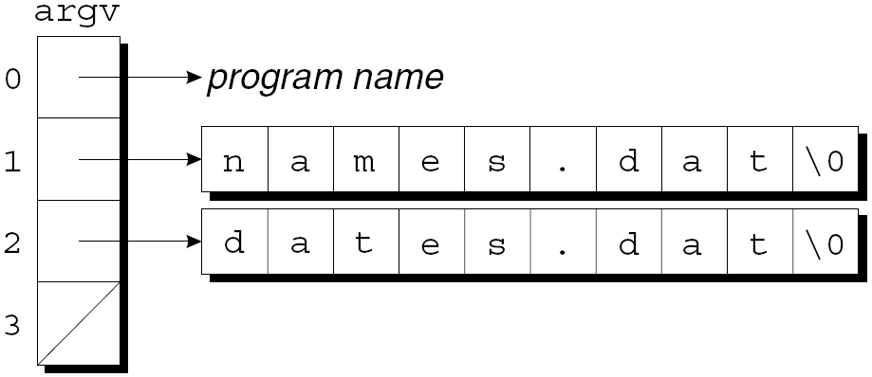
Obtaining File Names from the Command Line
argv[0] points to the program name, argv[1] through argv[argc-1] point to the remaining arguments, and argv[argc] is a null pointer.
In the demo example, argc is 3 and argv has the following appearance:

Slide 41
Program: Checking Whether a File Can Be Opened
The canopen.c program determines if a file exists and can be opened for reading.
The user will give the program a file name to check:
canopen file
The program will then print either file can be opened or file can't be opened.
If the user enters the wrong number of arguments on the command line, the program will print the message usage: canopen filename.

Slide 42
/* Checks whether a file can be opened for reading */
#include <stdio.h>
#include <stdlib.h>
int main(int argc, char *argv[])
{
FILE *fp;
if (argc != 2) {
printf("usage: canopen filename\n");
exit(EXIT_FAILURE);
}
if ((fp = fopen(argv[1], "r")) == NULL) {
printf("%s can't be opened\n", argv[1]);
exit(EXIT_FAILURE);
}
printf("%s can be opened\n", argv[1]);
fclose(fp);
return 0;
}
canopen.c

Slide 43
Temporary Files
Programs often need to create temporary files—files that exist only as long as the program is running.
<stdio.h> provides two functions, tmpfile and tmpnam, for working with temporary files.

Slide 44
Temporary Files
tmpfile creates a temporary file (opened in "wb+" mode) that will exist until it’s closed or the program ends.
A call of tmpfile returns a file pointer that can be used to access the file later:
FILE *tempptr;
…
tempptr = tmpfile();
/* creates a temporary file */
If it fails to create a file, tmpfile returns a null pointer.

Slide 45
Temporary Files
Drawbacks of using tmpfile:
Don’t know the name of the file that tmpfile creates.
Can’t decide later to make the file permanent.
The alternative is to create a temporary file using fopen.
The tmpnam function is useful for ensuring that this file doesn’t have the same name as an existing file.

Slide 46
Temporary Files
tmpnam generates a name for a temporary file.
If its argument is a null pointer, tmpnam stores the file name in a static variable and returns a pointer to it:
char *filename;
…
filename = tmpnam(NULL);
/* creates a temporary file name */

Slide 47
Temporary Files
Otherwise, tmpnam copies the file name into a character array provided by the programmer:
char filename[L_tmpnam];
…
tmpnam(filename);
/* creates a temporary file name */
In this case, tmpnam also returns a pointer to the first character of this array.
L_tmpnam is a macro in <stdio.h> that specifies how long to make a character array that will hold a temporary file name.

Slide 48
Temporary Files
The TMP_MAX macro (defined in <stdio.h>) specifies the maximum number of temporary file names that can be generated by tmpnam.
If it fails to generate a file name, tmpnam returns a null pointer.

Slide 49
File Buffering
Transferring data to or from a disk drive is a relatively slow operation.
The secret to achieving acceptable performance is buffering.
Data written to a stream is actually stored in a buffer area in memory; when it’s full (or the stream is closed), the buffer is “flushed.”
Input streams can be buffered in a similar way: the buffer contains data from the input device; input is read from this buffer instead of the device itself.

Slide 50
File Buffering
Buffering can result in enormous gains in efficiency, since reading a byte from a buffer or storing a byte in a buffer is very fast.
It takes time to transfer the buffer contents to or from disk, but one large “block move” is much faster than many tiny byte moves.
The functions in <stdio.h> perform buffering automatically when it seems advantageous.
On rare occasions, we may need to use the functions fflush, setbuf, and setvbuf.

Slide 51
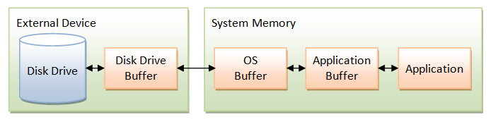
File Buffering
By calling fflush, a program can flush a file’s buffer as often as it wishes.
A call that flushes the buffer for the file associated with fp:
fflush(fp); /* flushes buffer for fp */
A call that flushes all output streams:
fflush(NULL); /* flushes all buffers */
fflush returns zero if it’s successful and EOF if an error occurs.

Slide 52
File Buffering
setvbuf allows us to change the way a stream is buffered and to control the size and location of the buffer.
The function’s third argument specifies the kind of buffering desired:
_IOFBF (full buffering)
_IOLBF (line buffering)
_IONBF (no buffering)
Full buffering is the default for streams that aren’t connected to interactive devices.

Slide 53
File Buffering
setvbuf’s second argument (if it’s not a null pointer) is the address of the desired buffer.
The buffer might have static storage duration, automatic storage duration, or even be allocated dynamically.
setvbuf’s last argument is the number of bytes in the buffer.

Slide 54
File Buffering
A call of setvbuf that changes the buffering of stream to full buffering, using the N bytes in the buffer array as the buffer:
char buffer[N];
…
setvbuf(stream, buffer, _IOFBF, N);
setvbuf must be called after stream is opened but before any other operations are performed on it.

Slide 55
File Buffering
It’s also legal to call setvbuf with a null pointer as the second argument, which requests that setvbuf create a buffer with the specified size.
setvbuf returns zero if it’s successful.
It returns a nonzero value if the mode argument is invalid or the request can’t be honored.

Slide 56
File Buffering
setbuf is an older function that assumes default values for the buffering mode and buffer size.
If buf is a null pointer, the call setbuf(stream, buf) is equivalent to
(void) setvbuf(stream, NULL, _IONBF, 0);
Otherwise, it’s equivalent to
(void) setvbuf(stream, buf, _IOFBF, BUFSIZ);
where BUFSIZ is a macro defined in <stdio.h>.
setbuf is considered to be obsolete.

Slide 57
File Buffering
#include <stdio.h>
int main()
{
char buff[1024];
memset( buff, '\0', sizeof( buff ));
fprintf(stdout, "Going to set full buffering on");
setvbuf(stdout, buff, _IOFBF, 1024);
fprintf(stdout, "This is gitbook.net");
fprintf(stdout, "This output will go into buff");
fflush( stdout );
fprintf(stdout, "and this will appear when programm");
fprintf(stdout, "will come after sleeping 5 seconds");
sleep(5);
return(0);
}

Slide 58
Miscellaneous File Operations
The remove and rename functions allow a program to perform basic file management operations.
Unlike most other functions in this section, remove and rename work with file names instead of file pointers.
Both functions return zero if they succeed and a nonzero value if they fail.

Slide 59
Miscellaneous File Operations
remove deletes a file:
remove("foo");
/* deletes the file named "foo" */
If a program uses fopen (instead of tmpfile) to create a temporary file, it can use remove to delete the file before the program terminates.
The effect of removing a file that’s currently open is implementation-defined.

Slide 60
Miscellaneous File Operations
rename changes the name of a file:
rename("foo", "bar");
/* renames "foo" to "bar" */
rename is handy for renaming a temporary file created using fopen if a program should decide to make it permanent.
If a file with the new name already exists, the effect is implementation-defined.
rename may fail if asked to rename an open file.

Slide 61
Formatted I/O
The next group of library functions use format strings to control reading and writing.
printf and related functions are able to convert data from numeric form to character form during output.
scanf and related functions are able to convert data from character form to numeric form during input.

Slide 62
The …printf Functions
The fprintf and printf functions write a variable number of data items to an output stream, using a format string to control the appearance of the output.
The prototypes for both functions end with the ... symbol (an ellipsis), which indicates a variable number of additional arguments:
int fprintf(FILE * restrict stream,
const char * restrict format, ...);
int printf(const char * restrict format, ...);
Both functions return the number of characters written; a negative return value indicates that an error occurred.

Slide 63
The …printf Functions
printf always writes to stdout, whereas fprintf writes to the stream indicated by its first argument:
printf("Total: %d\n", total);
/* writes to stdout */
fprintf(fp, "Total: %d\n", total);
/* writes to fp */
A call of printf is equivalent to a call of fprintf with stdout as the first argument.

Slide 64
The …printf Functions
fprintf works with any output stream.
One of its most common uses is to write error messages to stderr:
Writing a message to stderr guarantees that it will appear on the screen even if the user redirects stdout.
fprintf(stderr, "Error: data file can't be opened.\n");

Slide 65
The …printf Functions
Two other functions in <stdio.h> can write formatted output to a stream.
These functions, named vfprintf and vprintf, are fairly obscure.
Both rely on the va_list type, which is declared in <stdarg.h>, so they’re discussed along with that header.

Slide 66
…printf Conversion Specifications
Both printf and fprintf require a format string containing ordinary characters and/or conversion specifications.
Ordinary characters are printed as is.
Conversion specifications describe how the remaining arguments are to be converted to character form for display.

Slide 67
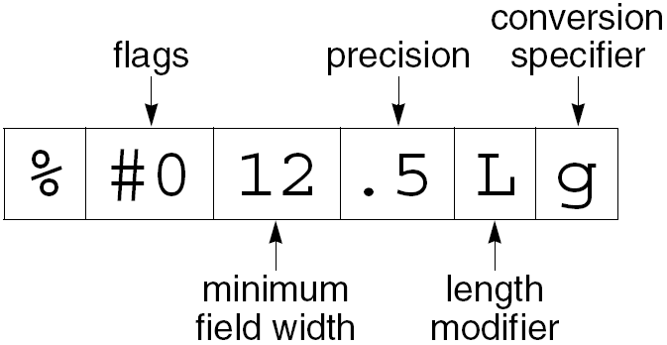
…printf Conversion Specifications
A …printf conversion specification consists of the % character, followed by as many as five distinct items:

Slide 68
…printf Conversion Specifications
Flags (optional; more than one permitted):
Flag Meaning
- Left-justify within field.
+ Numbers produced by signed conversions always begin with
+ or -.
space Nonnegative numbers produced by signed conversions are
preceded by a space.
# Octal numbers begin with 0, nonzero hexadecimal numbers
with 0x or 0X. Floating-point numbers always have a
decimal point. Trailing zeros aren’t removed from numbers
printed with the g or G conversions.
0 Numbers are padded with leading zeros up to the field width.
(zero)

Slide 69
…printf Conversion Specifications
Minimum field width (optional). An item that’s too small to occupy the field will be padded.
By default, spaces are added to the left of the item.
An item that’s too large for the field width will still be displayed in its entirety.
The field width is either an integer or the character *.
If * is present, the field width is obtained from the next argument.

Slide 70
…printf Conversion Specifications
Precision (optional). The meaning of the precision depends on the conversion:
d, i, o, u, x, X: minimum number of digits (leading zeros are
added if the number has fewer digits)
a, A, e, E, f, F: number of digits after the decimal point
g, G: number of significant digits
s: maximum number of bytes
The precision is a period (.) followed by an integer or the character *.
If * is present, the precision is obtained from the next argument.

Slide 71
…printf Conversion Specifications
Length modifier (optional). Indicates that the item to be displayed has a type that’s longer or shorter than normal.
%d normally refers to an int value; %hd is used to display a short int and %ld is used to display a long int.

Slide 72
…printf Conversion Specifications
Length
Modifier Conversion Specifiers Meaning
hh† d, i, o, u, x, X signed char, unsigned char
n signed char *
h d, i, o, u, x, X short int, unsigned short int
n short int *
l d, i, o, u, x, X long int, unsigned long int
(ell) n long int *
c wint_t
s wchar_t *
a, A, e, E, f, F, g, G no effect
†C99 only

Slide 73
…printf Conversion Specifications
Length
Modifier Conversion Specifiers Meaning
ll† d, i, o, u, x, X long long int,
(ell-ell) unsigned long long int
n long long int *
j† d, i, o, u, x, X intmax_t, uintmax_t
n intmax_t *
z† d, i, o, u, x, X size_t
n size_t *
t† d, i, o, u, x, X ptrdiff_t
n ptrdiff_t *
L a, A, e, E, f, F, g, G long double
†C99 only

Slide 74
…printf Conversion Specifications
Conversion specifier. Must be one of the characters in the following table.
Conversion
Specifier Meaning
d, i Converts an int value to decimal form.
o, u, x, X Converts an unsigned int value to base 8 (o), base
10 (u), or base 16 (x, X). x displays the hexadecimal
digits a–f in lower case; X displays them in upper case.
f, F† Converts a double value to decimal form, putting the
decimal point in the correct position. If no precision is
specified, displays six digits after the decimal point.
†C99 only

Slide 75
…printf Conversion Specifications
Conversion
Specifier Meaning
e, E Converts a double value to scientific notation. If no
precision is specified, displays six digits after the
decimal point. If e is chosen, the exponent is preceded
by the letter e; if E is chosen, the exponent is preceded
by E.
g, G g converts a double value to either f form or e form.
G chooses between F and E forms.
a†, A† Converts a double value to hexadecimal scientific
notation using the form [-]0xh.hhhhp±d. a displays
the hex digits a–f in lower case; A displays them in
upper case. The choice of a or A also affects the case of
the letters x and p.
†C99 only

Slide 76
…printf Conversion Specifications
Conversion
Specifier Meaning
c Displays an int value as an unsigned character.
s Writes the characters pointed to by the argument. Stops
writing when the number of bytes specified by the
precision (if present) is reached or a null character is
encountered.
p Converts a void * value to printable form.
n The corresponding argument must point to an object of
type int. Stores in this object the number of characters
written so far by this call of …printf; produces no
output.
% Writes the character %.

Slide 77
C99 Changes to …printf Conversion Specifications
C99 changes to the conversion specifications for printf and fprintf:
Additional length modifiers
Additional conversion specifiers
Ability to write infinity and NaN
Support for wide characters
Previously undefined conversion specifications now allowed

Slide 78
Examples of …printf Conversion Specifications
Examples showing the effect of flags on the %d conversion:
Conversion Result of Applying Result of Applying
Specification Conversion to 123 Conversion to –123
%8d •••••123 ••••-123
%-8d 123••••• -123••••
%+8d ••••+123 ••••-123
% 8d •••••123 ••••-123
%08d 00000123 -0000123
%-+8d +123•••• -123••••
%- 8d •123•••• -123••••
%+08d +0000123 -0000123
% 08d •0000123 -0000123

Slide 79
Examples of …printf Conversion Specifications
Examples showing the effect of the # flag on the o, x, X, g, and G conversions:
Conversion Result of Applying Result of Applying
Specification Conversion to 123 Conversion to 123.0
%8o •••••173
%#8o ••••0173
%8x ••••••7b
%#8x ••••0x7b
%8X ••••••7B
%#8X ••••0X7B
%8g •••••123
%#8g •123.000
%8G •••••123
%#8G •123.000

Slide 80
Examples of …printf Conversion Specifications
Examples showing the effect of the minimum field width and precision on the %s conversion:
Result of Applying Result of Applying
Conversion Conversion to Conversion to
Specification "bogus" "buzzword"
%6s •bogus buzzword
%-6s bogus• buzzword
%.4s bogu buzz
%6.4s ••bogu ••buzz
%-6.4s bogu•• buzz••

Slide 81
Examples of …printf Conversion Specifications
Examples showing how the %g conversion displays some numbers in %e form and others in %f form:
Result of Applying %.4g
Number Conversion to Number
123456. 1.235e+05
12345.6 1.235e+04
1234.56 123.5
123.456 123.5
12.3456 12.35
1.23456 1.235
.123456 0.1235
.0123456 0.01235
.00123456 0.001235
.000123456 0.0001235
.0000123456 1.235e-05
.00000123456 1.235e-06

Slide 82
Examples of …printf Conversion Specifications
The minimum field width and precision are usually embedded in the format string.
Putting the * character where either number would normally go allows us to specify it as an argument after the format string.
Calls of printf that produce the same output:
printf("%6.4d", i);
printf("%*.4d", 6, i);
printf("%6.*d", 4, i);
printf("%*.*d", 6, 4, i);

Slide 83
Examples of …printf Conversion Specifications
A major advantage of * is that it allows us to use a macro to specify the width or precision:
printf("%*d", WIDTH, i);
The width or precision can even be computed during program execution:
printf("%*d", page_width / num_cols, i);

Slide 84
Examples of …printf Conversion Specifications
The %p conversion is used to print the value of a pointer:
printf("%p", (void *) ptr);
/* displays value of ptr */
The pointer is likely to be shown as an octal or hexadecimal number.

Slide 85
Examples of …printf Conversion Specifications
The %n conversion is used to find out how many characters have been printed so far by a call of …printf.
After the following call, the value of len will be 3:
printf("%d%n\n", 123, &len);

Slide 86
The …scanf Functions
fscanf and scanf read data items from an input stream, using a format string to indicate the layout of the input.
After the format string, any number of pointers—each pointing to an object—follow as additional arguments.
Input items are converted (according to conversion specifications in the format string) and stored in these objects.

Slide 87
The …scanf Functions
scanf always reads from stdin, whereas fscanf reads from the stream indicated by its first argument:
scanf("%d%d", &i, &j);
/* reads from stdin */
A call of scanf is equivalent to a call of fscanf with stdin as the first argument.
fscanf(fp, "%d%d", &i, &j); /* reads from fp */

Slide 88
The …scanf Functions
Errors that cause the …scanf functions to return prematurely:
Input failure (no more input characters could be read)
Matching failure (the input characters didn’t match the format string)
In C99, an input failure can also occur because of an encoding error.

Slide 89
The …scanf Functions
The …scanf functions return the number of data items that were read and assigned to objects.
They return EOF if an input failure occurs before any data items can be read.
Loops that test scanf’s return value are common.
A loop that reads a series of integers one by one, stopping at the first sign of trouble:
while (scanf("%d", &i) == 1)
{
…
}

Slide 90
…scanf Format Strings
Calls of the …scanf functions resemble those of the …printf functions.
However, the …scanf functions work differently.
The format string represents a pattern that a …scanf function attempts to match as it reads input.
If the input doesn’t match the format string, the function returns.
The input character that didn’t match is “pushed back” to be read in the future.

Slide 91
…scanf Format Strings
A …scanf format string may contain three things:
Conversion specifications
White-space characters
Non-white-space characters

Slide 92
…scanf Format Strings
Conversion specifications. Conversion specifications in a …scanf format string resemble those in a …printf format string.
Most conversion specifications skip white-space characters at the beginning of an input item (the exceptions are %[, %c, and %n).
Conversion specifications never skip trailing white-space characters, however.

Slide 93
…scanf Format Strings
White-space characters. One or more white-space characters in a format string match zero or more white-space characters in the input stream.
Non-white-space characters. A non-white-space character other than % matches the same character in the input stream.

Slide 94
…scanf Format Strings
The format string "ISBN %d-%d-%ld-%d" specifies that the input will consist of:
the letters ISBN
possibly some white-space characters
an integer
the - character
an integer (possibly preceded by white-space characters)
the - character
a long integer (possibly preceded by white-space characters)
the - character
an integer (possibly preceded by white-space characters)

Slide 95
…scanf Conversion Specifications
A …scanf conversion specification consists of the character % followed by:
*
Maximum field width
Length modifier
Conversion specifier
* (optional). Signifies assignment suppression: an input item is read but not assigned to an object.
Items matched using * aren’t included in the count that …scanf returns.

Slide 96
…scanf Conversion Specifications
Maximum field width (optional). Limits the number of characters in an input item.
White-space characters skipped at the beginning of a conversion don’t count.
Length modifier (optional). Indicates that the object in which the input item will be stored has a type that’s longer or shorter than normal.
The table on the next slide lists each length modifier and the type indicated when it is combined with a conversion specifier.

Slide 97
…scanf Conversion Specifications
Length
Modifier Conversion Specifiers Meaning
hh† d, i, o, u, x, X, n signed char *, unsigned char *
h d, i, o, u, x, X, n short int *, unsigned short int *
l d, i, o, u, x, X, n long int *, unsigned long int *
(ell) a, A, e, E, f, F, g, G double *
c, s, or [ wchar_t *
ll† d, i, o, u, x, X, n long long int *,
(ell-ell) unsigned long long int *
j† d, i, o, u, x, X, n intmax_t *, uintmax_t *
z† d, i, o, u, x, X, n size_t *
t† d, i, o, u, x, X, n ptrdiff_t *
L a, A, e, E, f, F, g, G long double *
†C99 only

Slide 98
…scanf Conversion Specifications
Conversion specifier. Must be one of the characters in the following table.
Conversion
Specifier Meaning
d Matches a decimal integer; the corresponding argument
is assumed to have type int *.
i Matches an integer; the corresponding argument is
assumed to have type int *. The integer is assumed to
be in base 10 unless it begins with 0 (indicating octal)
or with 0x or 0X (hexadecimal).
o Matches an octal integer; the corresponding argument is assumed to have type unsigned int *.
u Matches a decimal integer; the corresponding argument
is assumed to have type unsigned int *.

Slide 99
…scanf Conversion Specifications
Conversion
Specifier Meaning
x, X Matches a hexadecimal integer; the corresponding
argument is assumed to have type unsigned int *.
a†, A†, e, E, Matches a floating-point number; the corresponding
f, F†, g, G argument is assumed to have type float *.
c Matches n characters, where n is the maximum field
width, or one character if no field width is specified. The
corresponding argument is assumed to be a pointer to a
character array (or a character object, if no field width is
specified). Doesn’t add a null character at the end.
s Matches a sequence of non-white-space characters, then
adds a null character at the end. The corresponding
argument is assumed to be a pointer to a character array.
†C99 only

Slide 100
…scanf Conversion Specifications
Conversion
Specifier Meaning
[ Matches a nonempty sequence of characters from a
scanset, then adds a null character at the end. The
corresponding argument is assumed to be a pointer to a character array.
p Matches a pointer value in the form that …printf
would have written it. The corresponding argument is
assumed to be a pointer to a void * object.
n The corresponding argument must point to an object of type int. Stores in this object the number of characters read so far by this call of …scanf. No input is consumed and the return value of …scanf isn’t affected.
% Matches the character %.

Slide 101
…scanf Conversion Specifications
Numeric data items can always begin with a sign (+ or -).
The o, u, x, and X specifiers convert the item to unsigned form, however, so they’re not normally used to read negative numbers.

Slide 102
…scanf Conversion Specifications
The [ specifier is a more complicated (and more flexible) version of the s specifier.
A conversion specification using [ has the form %[set] or %[^set], where set can be any set of characters.
%[set] matches any sequence of characters in set (the scanset).
%[^set] matches any sequence of characters not in set.
Examples:
%[abc] matches any string containing only a, b, and c.
%[^abc] matches any string that doesn’t contain a, b, or c.

Slide 103
…scanf Conversion Specifications
Many of the …scanf conversion specifiers are closely related to the numeric conversion functions in <stdlib.h>.
These functions convert strings (like "-297") to their equivalent numeric values (–297).
The d specifier, for example, looks for an optional + or - sign, followed by decimal digits; this is the same form that the strtol function requires.

Slide 104
…scanf Conversion Specifications
Correspondence between …scanf conversion specifiers and numeric conversion functions:
Conversion
Specifier Numeric Conversion Function
d strtol with 10 as the base
i strtol with 0 as the base
o strtoul with 8 as the base
u strtoul with 10 as the base
x, X strtoul with 16 as the base
a, A, e, E, f, F, g, G strtod

Slide 105
C99 Changes to …scanf Conversion Specifications
C99 changes to the conversion specifications for scanf and fscanf:
Additional length modifiers
Additional conversion specifiers
Ability to read infinity and NaN
Support for wide characters

Slide 106
scanf Examples
The next three tables contain sample calls of scanf.
Characters printed in strikeout are consumed by the call.

Slide 107
scanf Examples
Examples that combine conversion specifications, white-space characters, and non-white-space characters:
scanf Call Input Variables
n = scanf("%d%d", &i, &j); 12•,•34¤ n: 1
i: 12
j: unchanged
n = scanf("%d,%d", &i, &j); 12•,•34¤ n: 1
i: 12
j: unchanged
n = scanf("%d ,%d", &i, &j); 12•,•34¤ n: 2
i: 12
j: 34
n = scanf("%d, %d", &i, &j); 12•,•34¤ n: 1
i: 12
j: unchanged

Slide 108
scanf Examples
Examples showing the effect of assignment suppression and specifying a field width:
scanf Call Input Variables
n = scanf(“%*d%d", &i); 12•34¤ n: 1
i: 34
n = scanf("%*s%s", str); My•Fair•Lady¤ n: 1
str: "Fair"
n = scanf("%1d%2d%3d", 12345¤ n: 3
&i, &j, &k); i: 1
j: 23
k: 45
n = scanf("%2d%2s%2d", 123456¤ n: 3
&i, str, &j); i: 12
str: "34"
j: 56

Slide 109
scanf Examples
Examples that illustrate the i, [, and n conversion specifiers:
scanf Call Input Variables
n = scanf("%i%i%i", &i, &j, &k); 12•012•0x12¤ n: 3
i: 12
j: 10
k: 18
n = scanf("%[0123456789]", str); 123abc¤ n: 1
str: "123"
n = scanf("%[0123456789]", str); abc123¤ n: 0
str: unchanged
n = scanf("%[^0123456789]", str); abc123¤ n: 1
str: "abc"
n = scanf("%*d%d%n", &i, &j); 10•20•30¤ n: 1
i: 20
j: 5

Slide 110
Detecting End-of-File and Error Conditions
If we ask a …scanf function to read and store n data items, we expect its return value to be n.
If the return value is less than n, something went wrong:
End-of-file. The function encountered end-of-file before matching the format string completely.
Read error. The function was unable to read characters from the stream.
Matching failure. A data item was in the wrong format.

Slide 111
Detecting End-of-File and Error Conditions
Every stream has two indicators associated with it: an error indicator and an end-of-file indicator.
These indicators are cleared when the stream is opened.
Encountering end-of-file sets the end-of-file indicator, and a read error sets the error indicator.
The error indicator is also set when a write error occurs on an output stream.
A matching failure doesn’t change either indicator.

Slide 112
Detecting End-of-File and Error Conditions
Once the error or end-of-file indicator is set, it remains in that state until it’s explicitly cleared, perhaps by a call of the clearerr function.
clearerr clears both the end-of-file and error indicators:
clearerr(fp);
/* clears eof and error indicators for fp */
clearerr isn’t needed often, since some of the other library functions clear one or both indicators as a side effect.

Slide 113
Detecting End-of-File and Error Conditions
The feof and ferror functions can be used to test a stream’s indicators to determine why a prior operation on the stream failed.
The call feof(fp) returns a nonzero value if the end-of-file indicator is set for the stream associated with fp.
The call ferror(fp) returns a nonzero value if the error indicator is set.

Slide 114
Detecting End-of-File and Error Conditions
When scanf returns a smaller-than-expected value, feof and ferror can be used to determine the reason.
If feof returns a nonzero value, the end of the input file has been reached.
If ferror returns a nonzero value, a read error occurred during input.
If neither returns a nonzero value, a matching failure must have occurred.
The return value of scanf indicates how many data items were read before the problem occurred.

Slide 115
Detecting End-of-File and Error Conditions
The find_int function is an example that shows how feof and ferror might be used.
find_int searches a file for a line that begins with an integer:
n = find_int("foo");
find_int returns the value of the integer that it finds or an error code:
–1 File can’t be opened
–2 Read error
–3 No line begins with an integer

Slide 116
int find_int(const char *filename)
{
FILE *fp = fopen(filename, "r");
int n;
if (fp == NULL) return -1; /* can't open file */
while (fscanf(fp, "%d", &n) != 1) {
if (ferror(fp)) {
fclose(fp);
return -2; /* read error */
}
if (feof(fp)) {
fclose(fp);
return -3; /* integer not found */
}
fscanf(fp, "%*[^\n]"); /* skips rest of line */
}
fclose(fp);
return n;
}

Slide 117
Character I/O
The next group of library functions can read and write single characters.
These functions work equally well with text streams and binary streams.
The functions treat characters as values of type int, not char.
One reason is that the input functions indicate an end-of-file (or error) condition by returning EOF, which is a negative integer constant.

Slide 118
Output Functions
putchar writes one character to the stdout stream:
putchar(ch); /* writes ch to stdout */
fputc and putc write a character to an arbitrary stream:
fputc(ch, fp); /* writes ch to fp */
putc(ch, fp); /* writes ch to fp */
putc is usually implemented as a macro (as well as a function), while fputc is implemented only as a function.

Slide 119
Output Functions
putchar itself is usually a macro:
#define putchar(c) putc((c), stdout)
The C standard allows the putc macro to evaluate the stream argument more than once, which fputc isn’t permitted to do.
Programmers usually prefer putc, which gives a faster program.
If a write error occurs, all three functions set the error indicator for the stream and return EOF.
Otherwise, they return the character that was written.

Slide 120
Input Functions
getchar reads a character from stdin:
ch = getchar();
fgetc and getc read a character from an arbitrary stream:
ch = fgetc(fp);
ch = getc(fp);
All three functions treat the character as an unsigned char value (which is then converted to int type before it’s returned).
As a result, they never return a negative value other than EOF.

Slide 121
Input Functions
getc is usually implemented as a macro (as well as a function), while fgetc is implemented only as a function.
getchar is normally a macro as well:
#define getchar() getc(stdin)
Programmers usually prefer getc over fgetc.

Slide 122
Input Functions
The fgetc, getc, and getchar functions behave the same if a problem occurs.
At end-of-file, they set the stream’s end-of-file indicator and return EOF.
If a read error occurs, they set the stream’s error indicator and return EOF.
To differentiate between the two situations, we can call either feof or ferror.

Slide 123
Input Functions
One of the most common uses of fgetc, getc, and getchar is to read characters from a file.
A typical while loop for that purpose:
while ((ch = getc(fp)) != EOF) {
…
}
Always store the return value in an int variable, not a char variable.
Testing a char variable against EOF may give the wrong result.

Slide 124
Input Functions
The ungetc function “pushes back” a character read from a stream and clears the stream’s end-of-file indicator.
A loop that reads a series of digits, stopping at the first nondigit:
while (isdigit(ch = getc(fp))) {
…
}
ungetc(ch, fp);
/* pushes back last character read */

Slide 125
Input Functions
The number of characters that can be pushed back by consecutive calls of ungetc varies; only the first call is guaranteed to succeed.
Calling a file-positioning function (fseek, fsetpos, or rewind) causes the pushed-back characters to be lost.
ungetc returns the character it was asked to push back.
It returns EOF if an attempt is made to push back EOF or to push back more characters than allowed.

Slide 126
Program: Copying a File
The fcopy.c program makes a copy of a file.
The names of the original file and the new file will be specified on the command line when the program is executed.
An example that uses fcopy to copy the file f1.c to f2.c:
fcopy f1.c f2.c
fcopy will issue an error message if there aren’t exactly two file names on the command line or if either file can’t be opened.

Slide 127
Program: Copying a File
Using "rb" and "wb" as the file modes enables fcopy to copy both text and binary files.
If we used "r" and "w" instead, the program wouldn’t necessarily be able to copy binary files.

Slide 128
FILE *sourceFp, *destFp;
int ch;
if (argc!= 3){
fprintf(stderr,"usage:fcopy source dest\n");
exit(EXIT_FAILURE);
}
if((sourceFp=fopen(argv[1], "rb"))== NULL) {
fprintf(stderr,"Can't open %s\n", argv[1]);
exit(EXIT_FAILURE);
}
if ((destFp= fopen(argv[2], "wb"))== NULL) {
fprintf(stderr,"Can't open %s\n", argv[2]);
fclose(sourceFp);
exit(EXIT_FAILURE);
}
while ((ch = getc(sourceFp)) != EOF)
putc(ch, destFp);
fclose(sourceFp); fclose(destFp); return 0;
fcopy.c
fcopy f1.c f2.c

Slide 129
Line I/O
Library functions in the next group are able to read and write lines.
These functions are used mostly with text streams, although it’s legal to use them with binary streams as well.

Slide 130
Output Functions
The puts function writes a string of characters to stdout:
puts("Hi, there!"); /* writes to stdout */
After it writes the characters in the string, puts always adds a new-line character.

Slide 131
Output Functions
fputs is a more general version of puts.
Its second argument indicates the stream to which the output should be written:
fputs("Hi, there!", fp); /* writes to fp */
Unlike puts, the fputs function doesn’t write a new-line character unless one is present in the string.
Both functions return EOF if a write error occurs; otherwise, they return a nonnegative number.

Slide 132
Input Functions
The gets function reads a line of input from stdin:
gets(str); /* reads a line from stdin */
gets reads characters one by one, storing them in the array pointed to by str, until it reads a new-line character (which it discards).
fgets is a more general version of gets that can read from any stream.
fgets is also safer than gets, since it limits the number of characters that it will store.

Slide 133
Input Functions
A call of fgets that reads a line into a character array named str:
fgets(str, sizeof(str), fp);
fgets will read characters until it reaches the first new-line character or sizeof(str) – 1 characters have been read.
If it reads the new-line character, fgets stores it along with the other characters.

Slide 134
Input Functions
Both gets and fgets return a null pointer if a read error occurs or they reach the end of the input stream before storing any characters.
Otherwise, both return their first argument, which points to the array in which the input was stored.
Both functions store a null character at the end of the string.

Slide 135
Input Functions
fgets should be used instead of gets in most situations.
gets is safe to use only when the string being read is guaranteed to fit into the array.
When there’s no guarantee (and there usually isn’t), it’s much safer to use fgets.
fgets will read from the standard input stream if passed stdin as its third argument:
fgets(str, sizeof(str), stdin);

Slide 136
OPENING, READING, WRITING one line of characters
enum {SUCCESS, FAIL, MAX_LEN = 100};
void LineReadWrite(FILE *fin, FILE *fout);
int main(void)
{
FILE *fptr1, *fptr2;
char filename1[] = "c:\\testhree.txt";
char filename2[] = "c:\\testfour.txt";
char reval = SUCCESS;
// test opening testhree.txt file for writing, if fail...
if((fptr1 = fopen(filename1,“w”)) == NULL)
{ … . reval = FAIL; }
else if((fptr2=fopen(filename2, "r"))==NULL)
{ … reval = FAIL; }
else
{ // function call for read and write, line by line...
LineReadWrite(fptr2, fptr1);
// close both files stream...
if(fclose(fptr1)==0) printf("%s successfully closed.\n", filename1);
if(fclose(fptr2)==0) printf("%s successfully closed.\n", filename2);
}
return reval;
}

Slide 137
void LineReadWrite(FILE *fin, FILE *fout)
{
char buff[MAX_LEN];
while(fgets(buff, MAX_LEN, fin) !=NULL)
{
fputs(buff, fout);
// write to screen...
printf("%s", buff);
}
}

Slide 138
Block I/O
The fread and fwrite functions allow a program to read and write large blocks of data in a single step.
fread and fwrite are used primarily with binary streams, although—with care—it’s possible to use them with text streams as well.

Slide 139
Block I/O
fwrite is designed to copy an array from memory to a stream.
Arguments in a call of fwrite:
Address of array
Size of each array element (in bytes)
Number of elements to write
File pointer
A call of fwrite that writes the entire contents of the array a:
fwrite(a,sizeof(a[0]),sizeof(a)/sizeof(a[0]),fp);

Slide 140
Block I/O
fwrite returns the number of elements actually written.
This number will be less than the third argument if a write error occurs.

Slide 141
Block I/O
fread will read the elements of an array from a stream.
A call of fread that reads the contents of a file into the array a:
n=fread(a,sizeof(a[0]),sizeof(a)/sizeof(a[0]),fp);
fread’s return value indicates the actual number of elements read.
This number should equal the third argument unless the end of the input file was reached or a read error occurred.

Slide 142
Block I/O
fwrite is convenient for a program that needs to store data in a file before terminating.
Later, the program (or another program) can use fread to read the data back into memory.
The data doesn’t need to be in array form.
A call of fwrite that writes a structure variable s to a file:
fwrite(&s, sizeof(s), 1, fp);

Slide 143
struct rec { int x,y,z; };
int main() {
int counter;
FILE *ptrMyfile;
struct rec myRecord;
ptrMyfile= fopen("test.bin","wb");
if (!ptrMyfile)
{
printf("Unable to open file!");
return 1;
}
for ( counter=1; counter <= 10; counter++)
{
myRecord.x= counter;
fwrite(&myRecord, sizeof(struct rec), 1, ptrMyfile);
}
fclose(ptrMyfile);
return 0;
}
OPENING, READING AND WRITING ONE BLOCK OF DATA
Example I

Slide 144
struct rec { int x,y,z; };
int main()
{
int counter;
FILE *ptrMyfile;
struct rec myRecord;
ptrMyfile=fopen("test.bin","rb");
if (!ptrMyfile) {
printf("Unable to open file!");
return 1;
}
for ( counter=1; counter <= 10; counter++) {
fread(&myRecord, sizeof(struct rec), 1, ptrMyfile);
printf("%d\n",myRecord.x);
}
fclose(ptrMyfile);
return 0;
}
Example II

Slide 145
enum {SUCCESS, FAIL, MAX_LEN = 80};
void BlockReadWrite(FILE *fin, FILE *fout);
int ErrorMsg(char *str);
int main(void) {
FILE *fptr1, *fptr2;
char filename1[] = "c:\\Temp\\testfive.txt";
char filename2[] = "c:\\Temp\\testsix.txt";
int reval = SUCCESS;
if((fptr1 = fopen(filename1, "w")) == NULL) { … reval = ErrorMsg(filename1); }
else if ((fptr2 = fopen(filename2, "r")) == NULL)
{ reval = ErrorMsg(filename2); }
else
{
BlockReadWrite(fptr2, fptr1);
if(fclose(fptr1)==0) printf("%s successfully closed\n", filename1);
if(fclose(fptr2)==0) printf("%s successfully closed\n", filename2);
}
printf("\n");
return reval;
}
Example III

Slide 146
void BlockReadWrite(FILE *fin, FILE *fout)
{
int num;
char buff[MAX_LEN + 1];
// while not end of file for input file, do...
while(!feof(fin))
{
// reading...
num = fread(buff, sizeof(char), MAX_LEN, fin);
//append a null character
buff[num * sizeof(char)] = '\0';
printf("%s", buff);
// writing...
fwrite(buff, sizeof(char), num, fout);
}
}
int ErrorMsg(char *str)
{
printf("Problem, cannot open %s.\n", str);
return FAIL;
}

Slide 147
#include <stdio.h>
#include <stdlib.h>
#define NAME_LEN 25
#define MAX_PARTS 100
struct part {
int number;
char name[NAME_LEN+1];
int onHand;
} inventory[MAX_PARTS];
int numParts;
int main(void)
{
FILE *fp;
int i;
if ((fp = fopen("inventory.dat", "rb+")) == NULL) {
fprintf(stderr, "Can't open inventory file\n");
exit(EXIT_FAILURE);
}
numParts = fread(inventory, sizeof(struct part), MAX_PARTS, fp);
for (i = 0; i < numParts; i++) inventory[i].onHand = 0;
rewind(fp);
fwrite(inventory, sizeof(struct part), numParts, fp);
fclose(fp);
return 0;
}
invclear.c

Slide 148
File Positioning
Every stream has an associated file position.
When a file is opened, the file position is set at the beginning of the file.
In “append” mode, the initial file position may be at the beginning or end, depending on the implementation.
When a read or write operation is performed, the file position advances automatically, providing sequential access to data.

Slide 149
File Positioning
Although sequential access is fine for many applications, some programs need the ability to jump around within a file.
If a file contains a series of records, we might want to jump directly to a particular record.
<stdio.h> provides five functions that allow a program to determine the current file position or to change it.

Slide 150
File Positioning
The fseek function changes the file position associated with the first argument (a file pointer).
The third argument is one of three macros:
SEEK_SET Beginning of file
SEEK_CUR Current file position
SEEK_END End of file
The second argument, which has type long int, is a (possibly negative) byte count.

Slide 151
File Positioning
Using fseek to move to the beginning of a file:
fseek(fp, 0L, SEEK_SET);
Using fseek to move to the end of a file:
fseek(fp, 0L, SEEK_END);
Using fseek to move back 10 bytes:
fseek(fp, -10L, SEEK_CUR);
If an error occurs (the requested position doesn’t exist, for example), fseek returns a nonzero value.

Slide 152
File Positioning
The file-positioning functions are best used with binary streams.
C doesn’t prohibit programs from using them with text streams, but certain restrictions apply.
For text streams, fseek can be used only to move to the beginning or end of a text stream or to return to a place that was visited previously.
For binary streams, fseek isn’t required to support calls in which the third argument is SEEK_END.

Slide 153
File Positioning
The ftell function returns the current file position as a long integer.
The value returned by ftell may be saved and later supplied to a call of fseek:
long filePos;
…
filePos = ftell(fp);
/* saves current position */
…
fseek(fp, filePos, SEEK_SET);
/* returns to old position */

Slide 154
File Positioning
If fp is a binary stream, the call ftell(fp) returns the current file position as a byte count, where zero represents the beginning of the file.
If fp is a text stream, ftell(fp) isn’t necessarily a byte count.
As a result, it’s best not to perform arithmetic on values returned by ftell.

Slide 155
File Positioning
The rewind function sets the file position at the beginning.
The call rewind(fp) is nearly equivalent to fseek(fp, 0L, SEEK_SET).
The difference? rewind doesn’t return a value but does clear the error indicator for fp.

Slide 156
#include<stdio.h>
struct rec { int x,y,z; };
int main()
{
int counter;
FILE *ptrMyfile;
struct rec myRecord;
ptrMyfile=fopen("test.bin","rb");
if (! ptrMyfile) {printf("Unable to open file!"); return 1; }
fseek(ptrMyfile, sizeof(struct rec), SEEK_END);
rewind(ptrMyfile);
for ( counter=1; counter <= 10; counter++) {
fread(& myRecord,sizeof(struct rec),1, ptrMyfile);
printf("%d\n", myRecord.x);
}
fclose(ptrMyfile);
return 0;
}

Slide 157
File Positioning
fseek and ftell are limited to files whose positions can be stored in a long integer.
For working with very large files, C provides two additional functions: fgetpos and fsetpos.
These functions can handle large files because they use values of type fpos_t to represent file positions.
An fpos_t value isn’t necessarily an integer; it could be a structure, for instance.

Slide 158
File Positioning
The call fgetpos(fp, &file_pos) stores the file position associated with fp in the file_pos variable.
The call fsetpos(fp, &file_pos) sets the file position for fp to be the value stored in file_pos.
If a call of fgetpos or fsetpos fails, it stores an error code in errno.
Both functions return zero when they succeed and a nonzero value when they fail.

Slide 159
File Positioning
An example that uses fgetpos and fsetpos to save a file position and return to it later:
fpos_t file_pos;
…
fgetpos(fp, &file_pos);
/* saves current position */
…
fsetpos(fp, &file_pos);
/* returns to old position */

Slide 160
Program: Modifying a File of Part Records
Actions performed by the invclear.c program:
Opens a binary file containing part structures.
Reads the structures into an array.
Sets the on_hand member of each structure to 0.
Writes the structures back to the file.
The program opens the file in "rb+" mode, allowing both reading and writing.

Slide 161
String I/O
The functions described in this section can read and write data using a string as though it were a stream.
sprintf and snprintf write characters into a string.
sscanf reads characters from a string.

Slide 162
String I/O
Three similar functions (vsprintf, vsnprintf, and vsscanf) also belong to <stdio.h>.
These functions rely on the va_list type, which is declared in <stdarg.h>, so they are discussed in Chapter 26.

Slide 163
Output Functions
The sprintf function writes output into a character array (pointed to by its first argument) instead of a stream.
A call that writes "9/20/2010" into date:
sprintf(date, "%d/%d/%d", 9, 20, 2010);
sprintf adds a null character at the end of the string.
It returns the number of characters stored (not counting the null character).

Slide 164
Output Functions
sprintf can be used to format data, with the result saved in a string until it’s time to produce output.
sprintf is also convenient for converting numbers to character form.

Slide 165
Output Functions
The snprintf function (new in C99) is the same as sprintf, except for an additional second parameter named n.
No more than n – 1 characters will be written to the string, not counting the terminating null character, which is always written unless n is zero.
Example:
snprintf(name, 13,"%s, %s", "Einstein", "Albert");
The string "Einstein, Al" is written into name.

Slide 166
Output Functions
snprintf returns the number of characters that would have been written (not including the null character) had there been no length restriction.
If an encoding error occurs, snprintf returns a negative number.
To see if snprintf had room to write all the requested characters, we can test whether its return value was nonnegative and less than n.

Slide 167
/* sprintf example */
#include <stdio.h>
int main ()
{
char buffer [50];
int n, a=5, b=3;
n=sprintf (buffer, "%d plus %d is %d", a, b, a+b);
printf (“[%s] is a string %d chars long\n”, buffer, n);
return 0;
}
Output:
[5 plus 3 is 8] is a string 13 chars long

Slide 168
Input Functions
The sscanf function is similar to scanf and fscanf.
sscanf reads from a string (pointed to by its first argument) instead of reading from a stream.
sscanf’s second argument is a format string identical to that used by scanf and fscanf.

Slide 169
Input Functions
sscanf is handy for extracting data from a string that was read by another input function.
An example that uses fgets to obtain a line of input, then passes the line to sscanf for further processing:
fgets(str, sizeof(str), stdin);
/* reads a line of input */
sscanf(str, "%d%d", &i, &j);
/* extracts two integers */

Slide 170
Input Functions
One advantage of using sscanf is that we can examine an input line as many times as needed.
This makes it easier to recognize alternate input forms and to recover from errors.
Consider the problem of reading a date that’s written either in the form month/day/year or month-day-year:
if (sscanf(str, "%d /%d /%d", &month, &day, &year) == 3)
printf("Month: %d, day: %d, year: %d\n", month, day, year);
else if (sscanf(str, "%d -%d -%d", &month, &day, &year) == 3)
printf("Month: %d, day: %d, year: %d\n", month, day, year);
else
printf("Date not in the proper form\n");

Slide 171
Input Functions
Like the scanf and fscanf functions, sscanf returns the number of data items successfully read and stored.
sscanf returns EOF if it reaches the end of the string (marked by a null character) before finding the first item.

Slide 172
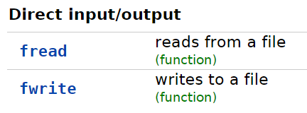
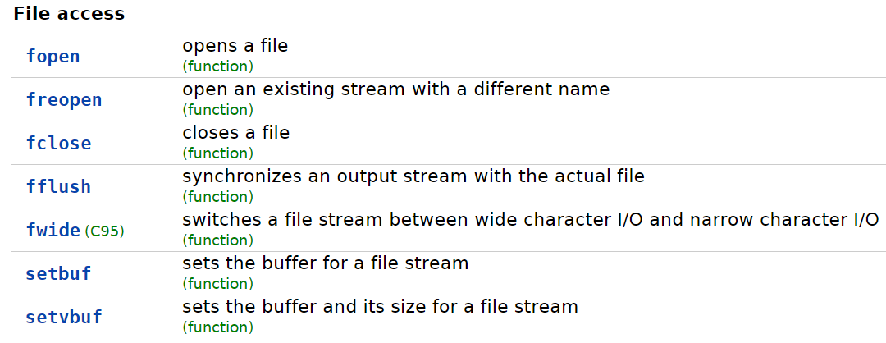
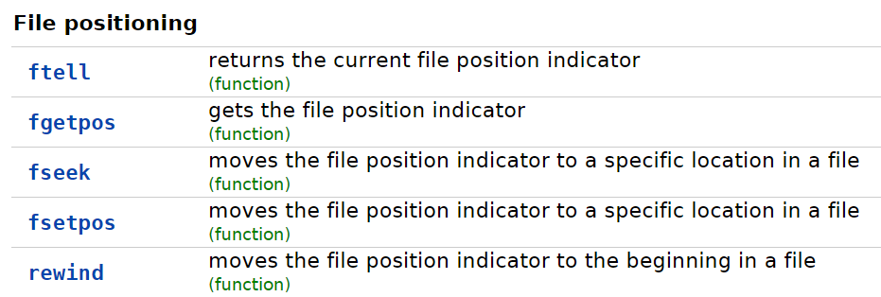
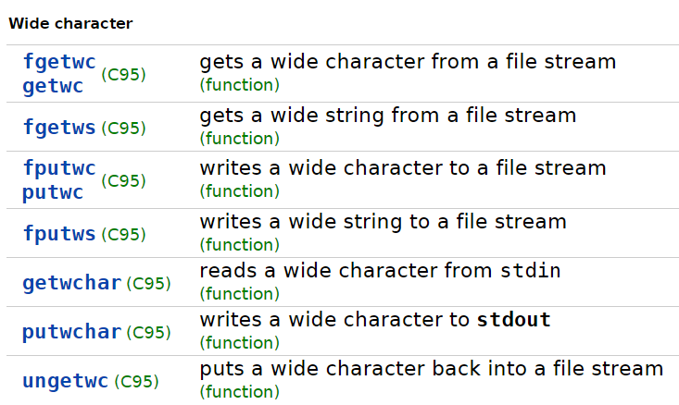
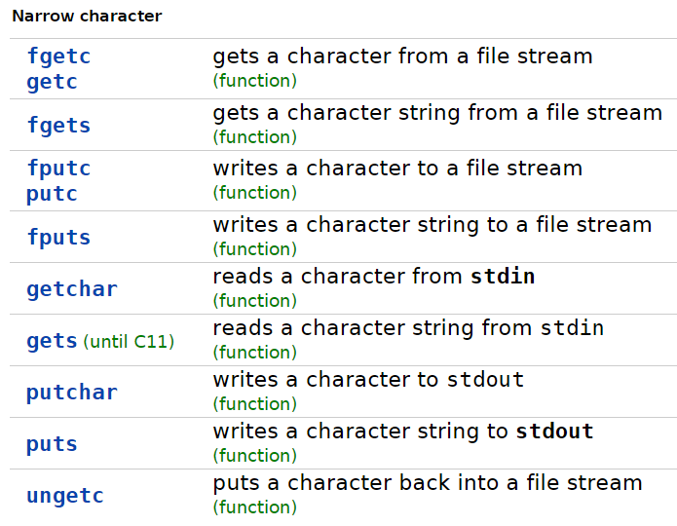
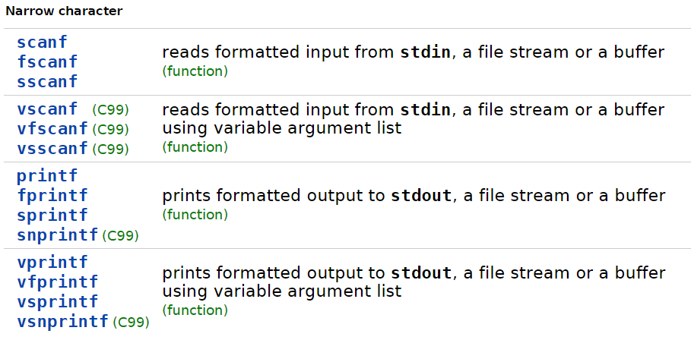
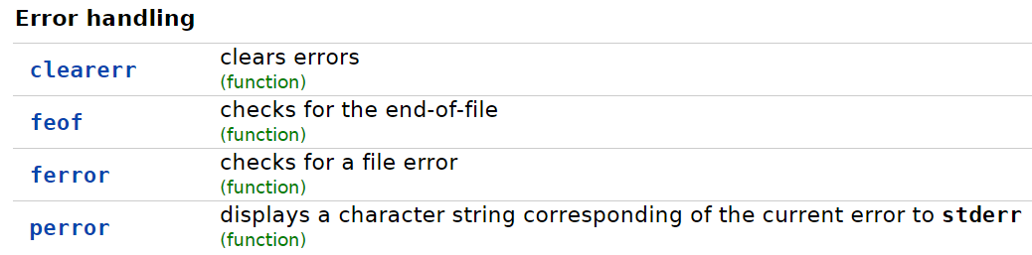
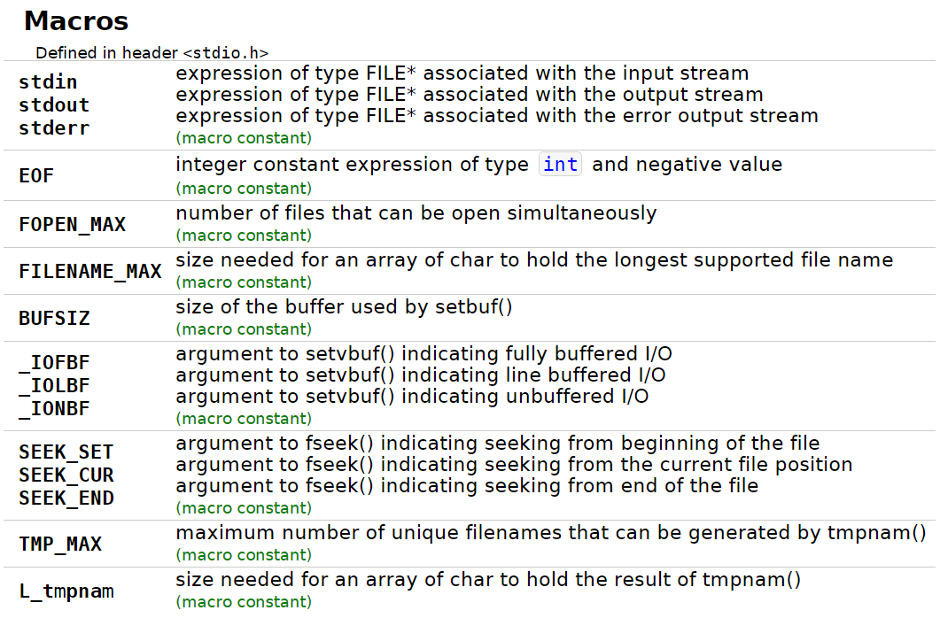
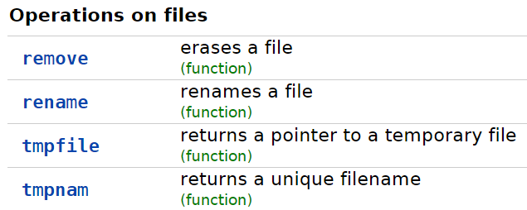
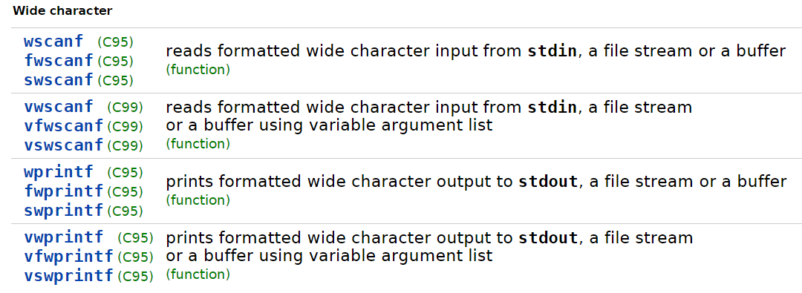
http://en.cppreference.com/w/c/io

